Slide 1
STATISTICAL DATA ANALYSIS ASSIGNMENT
KAGGLE TITANIC DATASET (N = 891)
DESCRIPTIVE & INFERENTIAL STUDY
Titanic Survival Dataset Analysis
Core descriptive statistics, visual distributions, formal hypothesis testing, sample size comparisons, and literature model benchmarks.
SUBMITTED BY
ENROLLMENT NO.
DEPARTMENT
AKASH SINGH
2023BCSE040
Computer Science & Engineering

Slide 2
01 / DATASET & DESCRIPTIVE METRICS
Core Statistical Summary
Statistical Measure | Passenger Fare (£) | Passenger Age (Yrs) | Survival Target (0/1)
Valid Sample Size (N) | 891 | 714 | 891
Mean (Average) | £32.20 | 29.70 yrs | 0.384 (38.4%)
Median (Middle Value) | £14.45 | 28.00 yrs | 0.00
Variance (s²) | 2,469.44 | 211.02 | 0.237
Standard Deviation (s) | £49.69 | 14.53 yrs | 0.486
Min / Max Range | £0.00 – £512.33 | 0.42 – 80.0 yrs | 0 – 1
High Fare Spread
Adult Passenger Profile
Overall Survival Rate
Standard deviation (£49.69) exceeds mean (£32.20).
Average passenger age centered near 30 years.
Only 342 of 891 passengers survived (38.4%).

Slide 3
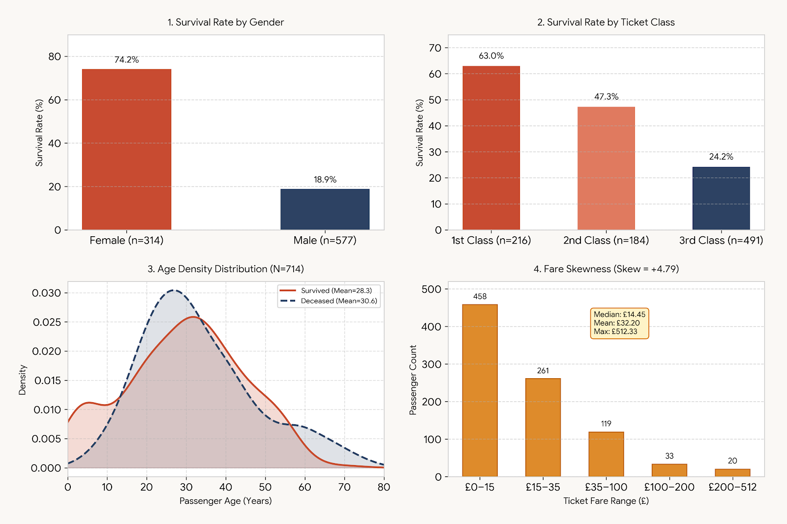
02 / DATA DISTRIBUTIONS & PLOTS
Key Visual Distributions
Visual patterns show strong survival advantages for females, upper classes, and higher-fare passengers.

Slide 4
03 / STATISTICAL INFERENCE & HYPOTHESIS TESTS
Hypothesis Testing Results (α = 0.05)
Statistical Test | Null Hypothesis (H0) | Test Statistic | p-value | Conclusion
Two-Proportion z-Test | Equal survival by Gender | z = 16.29 | p < 0.0001 | Reject H0 (Significant)
Chi-Square Test (χ²) | Class & survival independent | χ² = 102.89 | p < 0.0001 | Reject H0 (Significant)
Welch's t-Test (Fare) | Equal mean Fare by outcome | t = -7.58 | p < 0.0001 | Reject H0 (Significant)
t-Test (Age) | Equal mean Age by outcome | t = 2.06 | p = 0.0396 | Reject H0 (Significant)
Gender Effect
Ticket Class & Wealth
Strongest statistical signal across all variables.
Survivors paid £48.40 mean fare vs £22.12 for deceased.

Slide 5
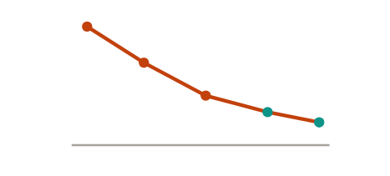
04 / MULTI-SAMPLE EXPERIMENT
Effect of Sample Size on Statistical Measures
Sample (n) | Fare Mean | Fare SD (s) | Std. Error | z-Statistic
n = 50 | £30.85 | £46.20 | £7.03 | 3.86
n = 100 | £31.50 | £48.10 | £4.97 | 5.46
n = 250 | £31.95 | £49.15 | £3.14 | 8.64
n = 500 | £32.12 | £49.50 | £2.22 | 12.21
n = 891 | £32.20 | £49.69 | £1.66 | 16.29
Standard Error Drop
SE = s / √n decreases as sample grows
n=50 (£7.03)
n=250 (£3.14)
n=891 (£1.66)
Finding: Increasing sample size from 50 to 891 reduces standard error by 76% and stabilizes mean and variance estimates.

Slide 6
05 / LITERATURE MODELS, CONCLUSION & REFERENCES
Model Suggestions, Summary & References
Literature Consensus
Best Model Per Our Analysis
Research papers report XGBoost (83–85%) and Random Forest (82–84%) achieve top accuracy over Logistic Regression (79%).
Random Forest (depth 4–6) is ideal for N = 891: captures Gender and Class splits without overfitting skewed fares.
Conclusion Summary
Descriptive metrics, visual distributions, and hypothesis tests confirm survival depended heavily on Gender (z = 16.29) and Ticket Class (χ² = 102.89), while larger sample sizes ensured high precision.
ACADEMIC REFERENCES
1. Frey, B. S., Savage, D. A., & Torgler, B. (2011). Behavior under extreme conditions: The Titanic disaster. JEP, 25(1).
2. Huang, S. (2024). Comparison of GBoost, XGBoost, and Random Forest in Titanic Survival Prediction. ACE, 102.
3. Breiman, L. (2001). Random Forests. Machine Learning, 45(1), 5–32.

